Slide 1


Slide 2

Sorting Algorithm
Bubble Sort
Insertion Sort
Selection Sort
Heap Sort

Slide 3

Brute Force
String Matching

Slide 4



Slide 5
Bubble Sort

Slide 6


Slide 7
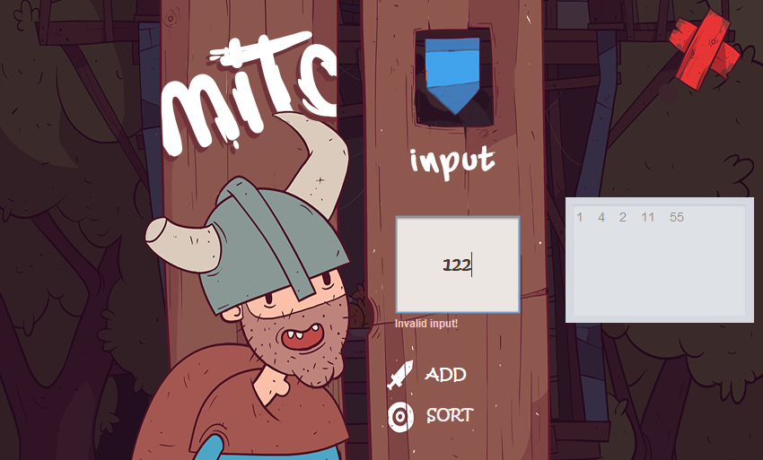

Slide 8
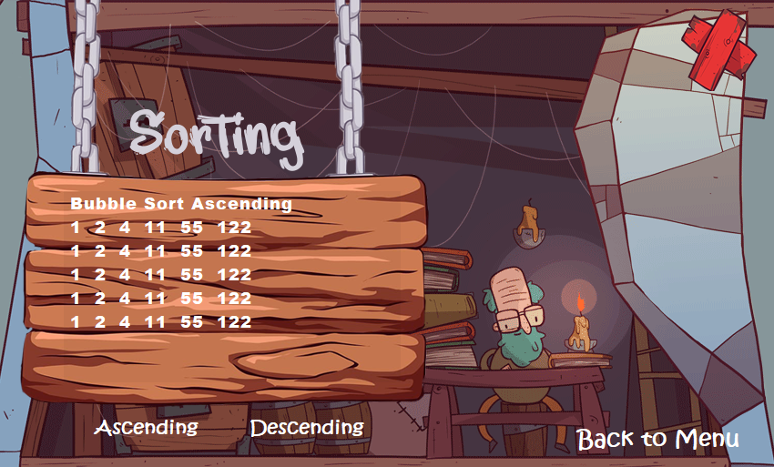
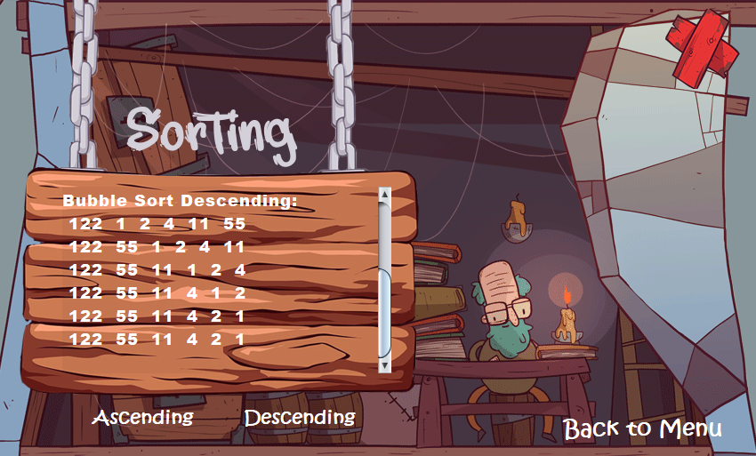

Slide 9
Insertion Sort

Slide 10


Slide 11
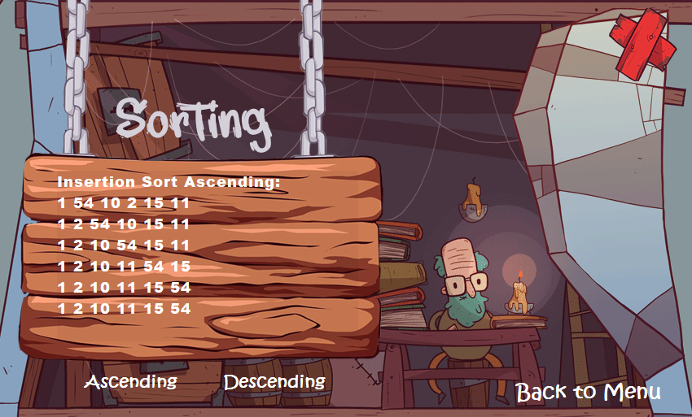
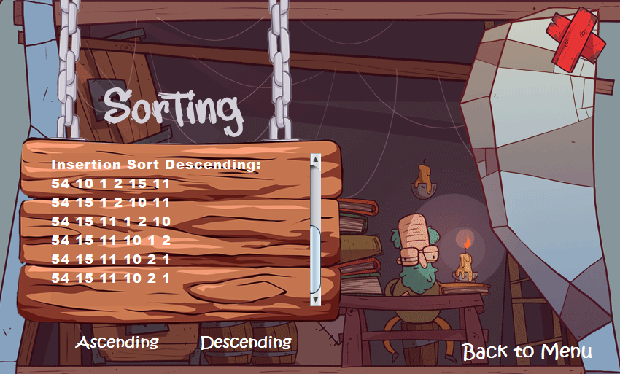

Slide 12
Selection Sort

Slide 13


Slide 14
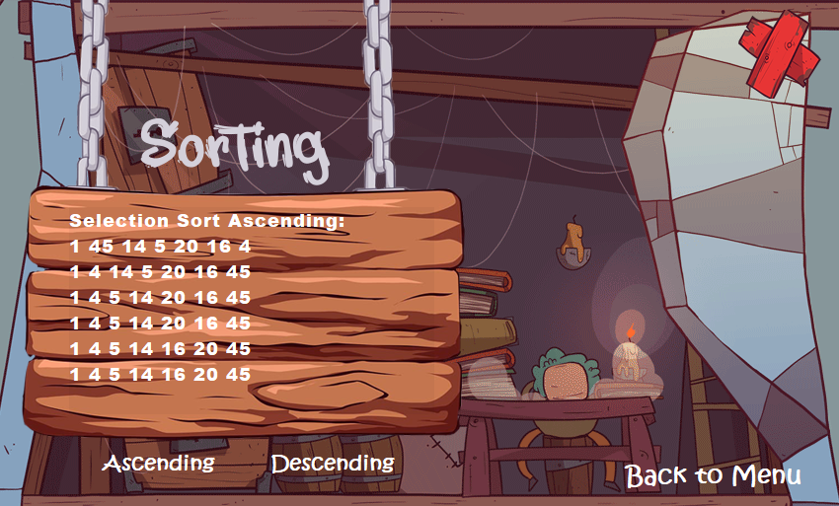
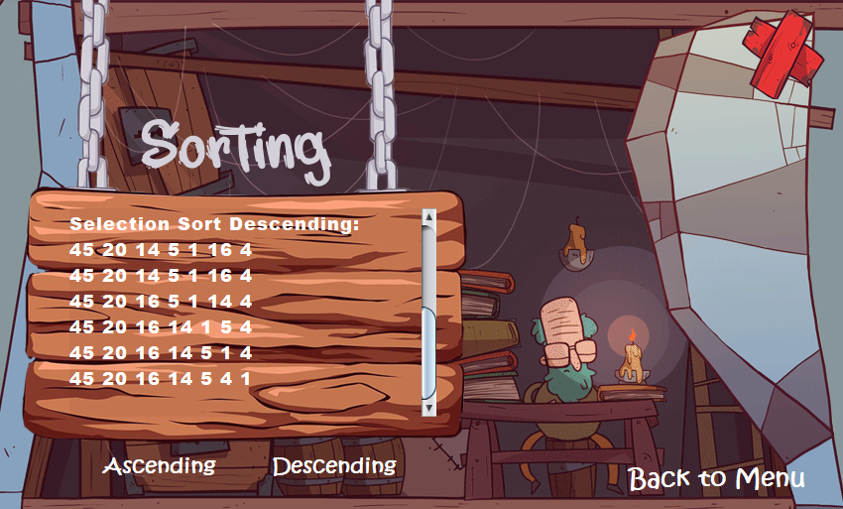

Slide 15
Heap Sort

Slide 16


Slide 17
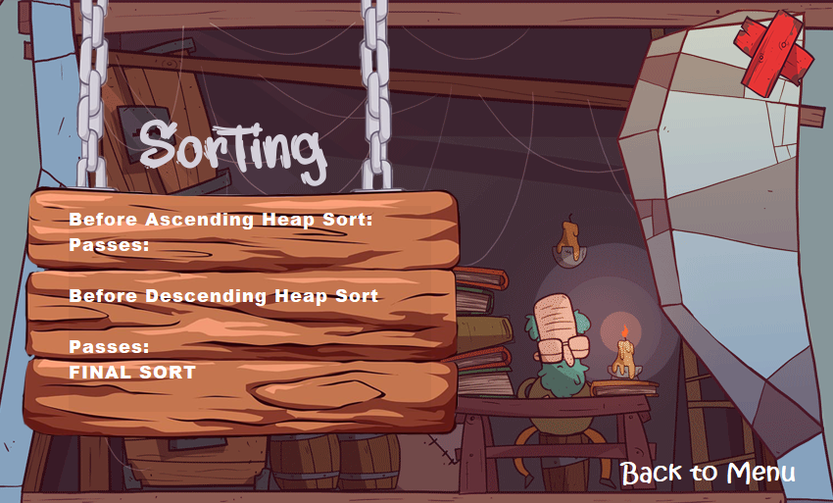

Slide 18
Brute Program

Slide 19


Slide 20
